Slide 1

SARS-Cov-2 Outbreak Analysis
-Ashish Agarwal

Slide 2
PRIME FOCUS
To study SARS-CoV-2 outbreak with the help of some basic visualizations’ techniques.
To Perform predictions and Time Series forecasting in order to study the impact and spread of the SARS-CoV-2 in coming days.
To have a sensible study to classify the trend of the number of infected people under the influence of different factors, and then modify the policy according to the trend of the expected number of infected people.
To study the responses of countries to SARS-CoV-2 i.e. to classify the changes in the number of infections in different countries, hoping to find out the factors that affect the country's ability to respond to it.
To analyze Growth Factor, Mortality and Recovery Rates.
To have an Exploratory Data analysis, Forecasting and implementing the Machine Learning Models wherever needed.
To study some important features that impact transmission rate of SARS-CoV-2 like Air Transmission, Relative humidity, Temperature and various other features.

Slide 3
”
—Oliver Markus Malloy, Inside The Mind of an Introvert
“If aliens wanted to exterminate us, they wouldn't send a fleet of spaceships or a Deathstar. They'd just send one guy with a deadly virus.”

Slide 4
WHOA!
Informing the population about the health risks posed by the coronavirus disease, as well as what they can do to protect themselves, is the best way to mitigate the spread and reduce the amount of further contagion cases

Slide 5
01. CAUSES
02. SPREAD
How do you get COVID-19?
Stats of the life cycle of the virus at certain surfaces
02. Infection data
04. prevention
Some numbers and data about the spread
Together we can overcome this pandemic

Slide 6
01. HOW do YOU get COVID-19?
A person can contract COVID-19 if:
They come in contact with another person infected with the virus
Someone infected coughs or sneezes directly to them
They touch any surface with little droplets from infected people’s cough or sneezes and then touch their eyes, nose or mouth

Slide 7
02.
THE VIRUS AND SURFACES
Find out how long the virus stays on different surfaces

Slide 8
COVID-19 IN DIFFERENT SURFACES
SURFACE | TIME
Sprayers | 3 hours
Copper | 4 hours
Plastic | 2-3 days
SURFACE | TIME
Cardboard | 24 hours
Steel | 2-3 days
Wood | 4 days

Slide 9
03.
INFECTION DATA
Some numbers and data on the spread of COVID-19

Slide 10
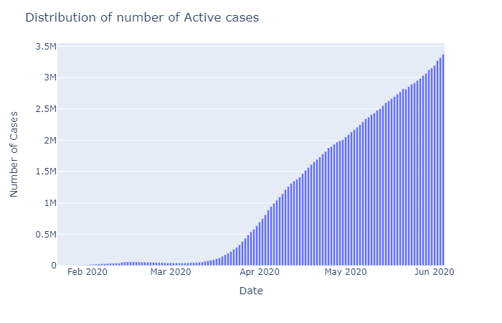
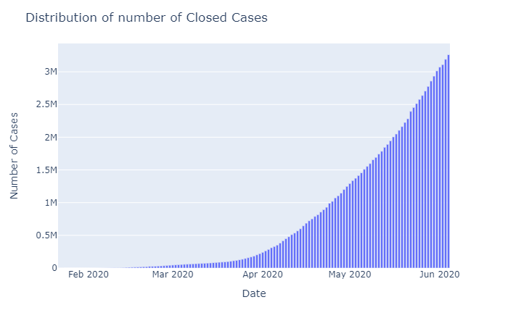
EXPONENTIAL GROWTH
No. of countries suffering: 223
Total no. of Confirmed Cases: 6632985
Total Recovered Cases worldwide: 2869963
Total Death Cases worldwide: 391136.0
Total Active Cases$=Total Confirmed Cases−Total Recovered Cases$
$$−Total Death Cases$$
Total Closed Cases$=Total Recovered Cases+Total Death Cases$

Slide 11
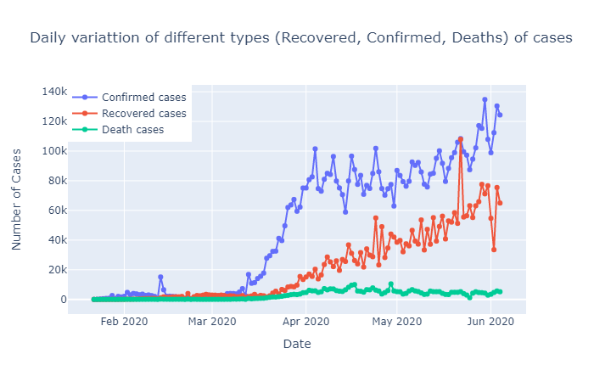
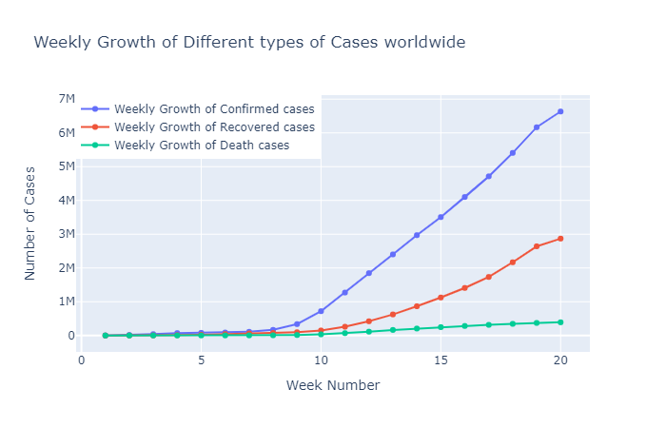
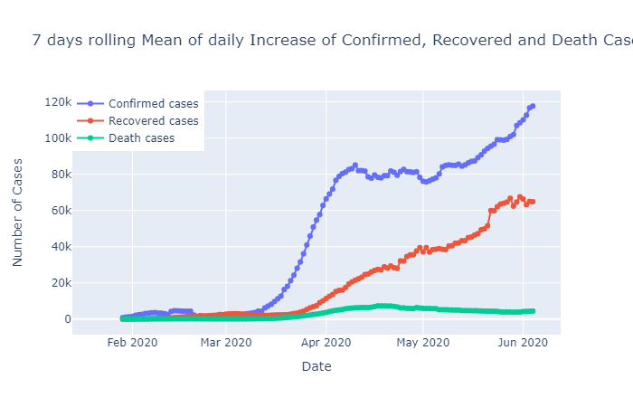
Trends (Confirmed, recovered and deaths)
Daily growth of confirmed cases is gradually increasing only but shows certain irregularity in its growth and this is amid the lockdown phase which is not a positive response. People seem not much frightened due to this pandemic as it has a low mortality rate and are continuing to disobey the strict imposition of rules and restriction.
Looking at the plot for Recovered cases, it has shown positive response amid the increase of confirmed cases. It has significantly taken a positive slope with reduced variations than confirmed cases is approaching the trend to confirmed cases which is a positive thing.
With the trend of Death cases, it gives a sense of relief that it's still keeping a constant growth rate and is not increasing. But our sole aim should be to bring it to zero and for that we need to follow the norms strictly.

Slide 12
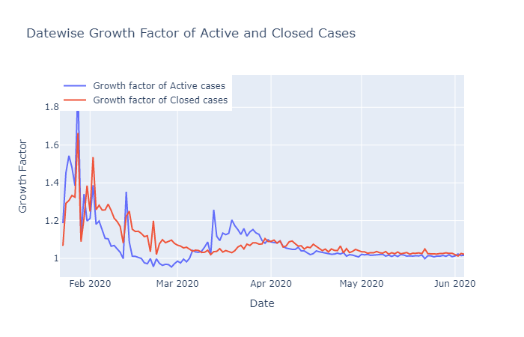
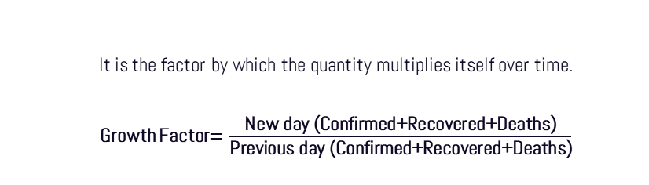
EVOLUTION OF THE AMOUNT OF CASES
It is the factor by which the quantity multiplies itself over time.
Growth Factor$=\frac{\text{New} \text{day}\text{ (}\text{Confirmed}\text{+}\text{Recovered}\text{+}\text{Deaths}\text{)}}{\text{Previous} \text{day}\text{ (}\text{Confirmed}\text{+}\text{Recovered}\text{+}\text{Deaths}\text{)}}$
As, it can be seen the Growth factor for all the different types of cases remains above 1 which is an indication that it's still in exponential growth phase but its relieving to observe that there is no uphill trend post March end and is lying close to 1 only through the time period.

Slide 13
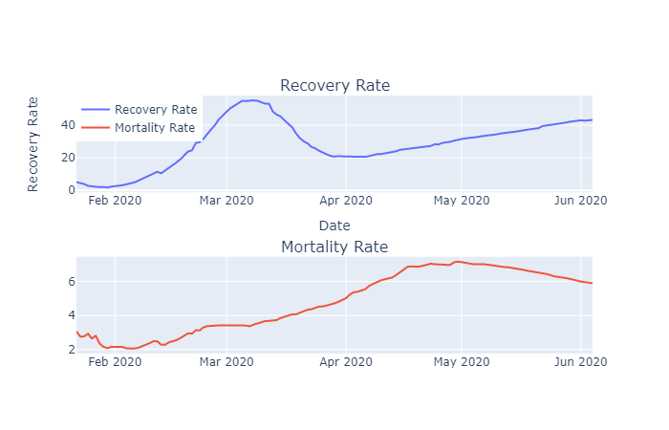


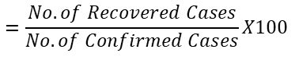
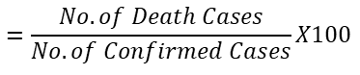
Mortality and recovery rate trends
Average Mortality Rate
4.7942
$$=\frac{No. of Death Cases}{No. of Confirmed Cases}X100$$
Average Recovery Rate
28.4811
$$=\frac{No. of Recovered Cases}{No. of Confirmed Cases}X100$$
From the above graphs one can infer that the recovery rate has picked up after a significant rise from early April due to complete lockdowns followed by most of the countries which is a good sign and the mortality rate is maintaining to be in single digits (around 6) which is also a positive response and has shown improvement from early May.

Slide 14
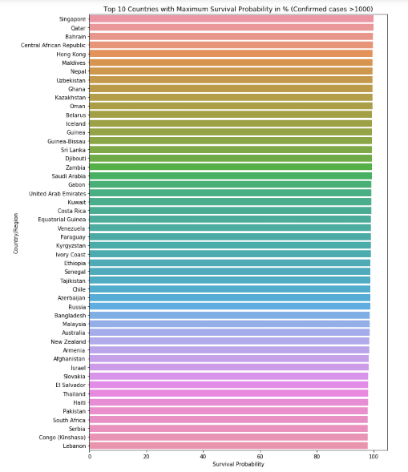
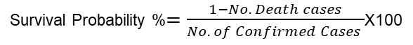
Survival probability
Survival Probability %$=\frac{1−No. Death cases}{No. of Confirmed Cases }$X100
Death Probability %$=1−Survival Probability$
Mean of Survival Probability 96.51480998851594
Median of Survival Probability 97.59736670360245
Mean of Death Probability 3.4851900114840646
Median of Death Probability 2.4026332963975534
This is a positive sign as almost all countries have Survival Probability of more than 95%

Slide 15
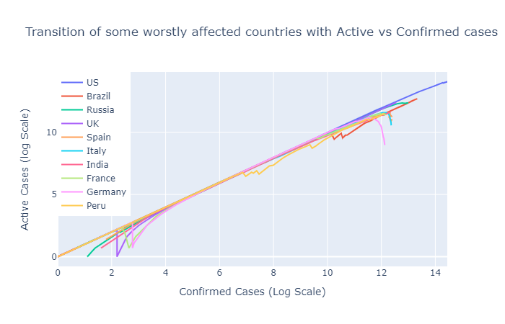
From this above graph one can infer that, most of the countries are following the trajectory similarly i.e. in uncontrolled Exponential growth. Some of the countries like Spain, Italy, Germany, Turkey are starting to get control over it as we can see a dip of the curve for them. Countries like USA, Russia, UK are still in exponential growth.

Slide 16
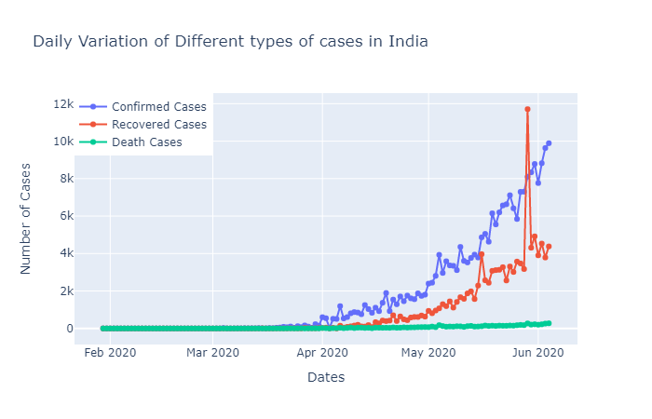
Trends in India
We see slow increase in confirmed cases from early April till early May. This was the time when every country was following the norms strictly. But with advent of mid May, some countries lifted off the complete lockdowns norms and imposed only partial lockdowns as the economy met an 'Worldwide Economic Depression'. This in an obvious practical sense created an uplift to the number of Confirmed cases through suspectable cases.
Recovered cases follows similar trend as like the previous plot and is continuing to increase only in its trend which is a positive sign.
Happy to see that the trend for death cases is taking a gradual dip after mid May and hope it continues to follow this trend only.

Slide 17
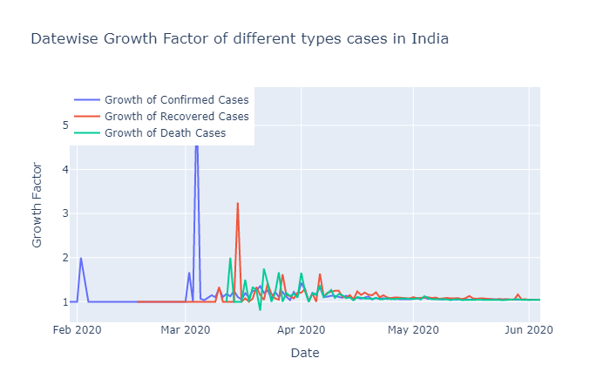
Analysis on India
Growth factor in India seem to be remaining constant for a long time now but is keeping its value a little above than one which says that its in exponential growth.

Slide 18
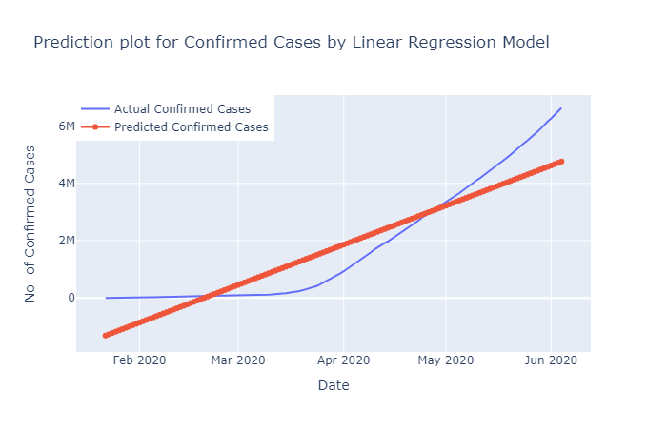
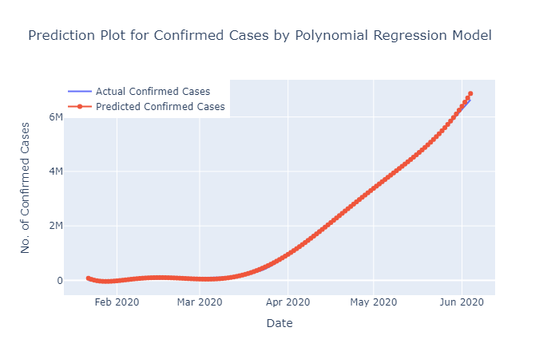
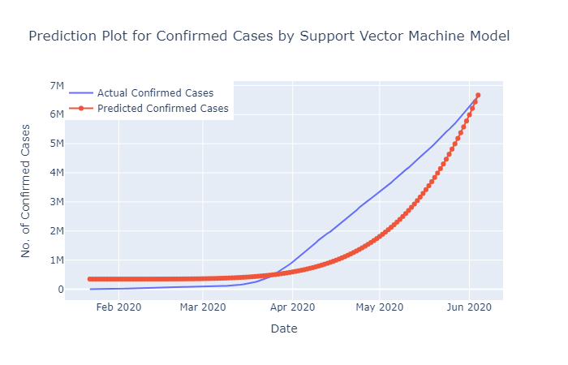
Machine Learning Models Predictions
Linear Regression
Polynomial Linear Regression
Support vector machine
RMSE:
656450.8172812837
RMSE:
142809.2735871889
RMSE:
336568.9331351328

Slide 19
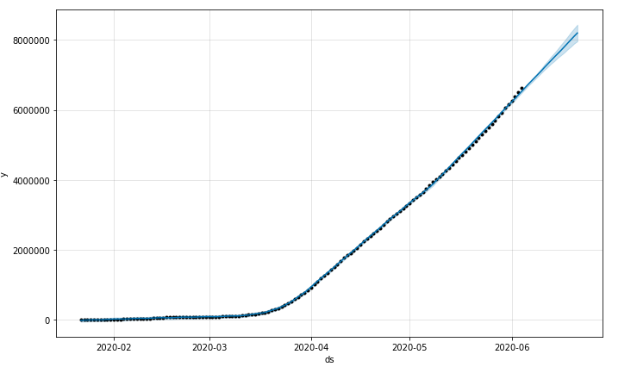
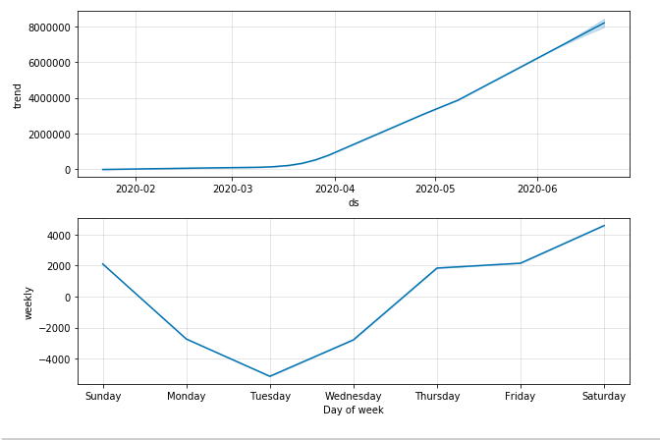
Machine Learning Models Predictions
Support vector machine
FACEBOOK PROPHET’S MODEL
RMSE: 22209.22
We Observe different number of cases as prediction by different Machine Learning Models but the one with the minimum error was found to be by Facebook Prophet’s Model. Therefore we may take this model as our best prediction model and we can also look around with model if it gets us lower RMSE than Facebook Prophets Model.

Slide 20
Impact of Natural and man-made factors
01
02
04
05
Population of a region
Average Density (P/ Sq. Km)
Avg Humidity
Avg Sun-Hour
06
07
08
09
Median Age of people
Avg Urban Percentage
ICU Beds / 1000 individuals
Avg Temp. in Celsius

Slide 21
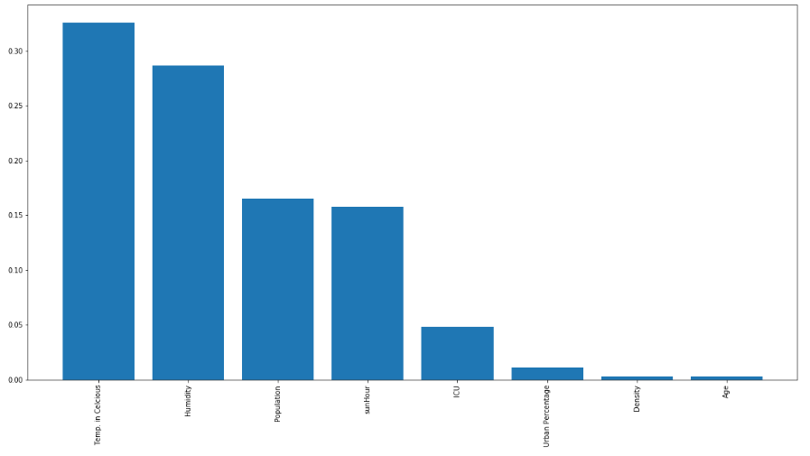
From the plot above we can see that many variables are positively correlated to the number of COVID19 infections and deaths such as: temperature, hours of sunlight, population, sun Hour, humidity, urban percentage ICU Beds available and age.

Slide 22
04.
PREVENTION: WHAT TO DO
Some advice to help prevent the spread of the virus

Slide 23
IF SOMEONE IN YOUR HOME IS SICK
01
02
03
Continue to practice everyday preventive actions as usual
Keep the ill person in a separate room from others in the household
If caring for a sick household member, monitor your own health too
04
05
06
Keep surfaces disinfected and also avoid sharing personal items
If you become sick, stay in contact with others by phone or email
Take care of the emotional health of your household members, including yourself

Slide 24
SOCIAL DISTANCING
ONE mETER
SAFE DISTANCE
OLDER ADULTS
Keep at least a distance of 1 meter (3 feet) between yourself and other people
Try not to come in contact with the elderly, as they are the most vulnerable to the virus

Slide 25
EMERGENCY WARNING SIGNS
03. Confusion or inability to wake up
01. Lips or face suddenly turning bluish
02. Persistent pressure in the chest
04. Difficulty or trouble when breathing

Slide 26
PROTECTION TIPS
Maintain social distancing
Keep objects and surfaces clean
Wash your hands frequently
Don’t touch eyes, nose or mouth

Slide 27
PUBLIC TRANSPORT RULES
Cash is not accepted (only cards)
Contact between driver and passenger must be kept to a minimum
Taxis and other vehicles for hire can only accept one passenger per fare (excepting underage and elderly people)
Cover yourself with your elbow when coughing and use hand sanitizer
Try not to touch anything

Slide 28
PERSONAL PROTECTIVE EQUIPMENT
01
Surgical masks and respirators
03
Safety gloves (must be worn to the wrist)
Lab coat or apron (wear it correctly)
Eye or face protection (such as glasses)
02
04

Slide 29

Clean frequently touched surfaces and objects

Slide 30
WASH YOUR HANDS
01
02
03
04
60% alcohol
Fingers
Palm to palm
Fingernails

Slide 31
WASH YOUR HANDS
05
06
07
08
Wrists
Thumbs
Rub until dry
Disinfected!

Slide 32

WE MUST each DO OUR part

Slide 33
RESOURCES
Articles:
https://www.ijidonline.com/action/showPdf?pii=S1201-9712%2820%2930123-5
https://www.sciencedirect.com/science/article/pii/S1201971220301235
https://www.ncbi.nlm.nih.gov/pmc/articles/PMC7098030/
https://www.ijidonline.com/article/S1201-9712(20)30123-5/fulltext
datasets:
https://www.kaggle.com/sudalairajkumar/novel-corona-virus-2019-dataset
https://www.kaggle.com/berkeleyearth/climate-change-earth-surface-temperature-data
https://www.kaggle.com/imdevskp/corona-virus-report
https://www.kaggle.com/parulpandey/coronavirus-cases-in-india
https://worldpopulationreview.com/countries/most-visited-countries/

Slide 34
THANKS!

